Slide 1
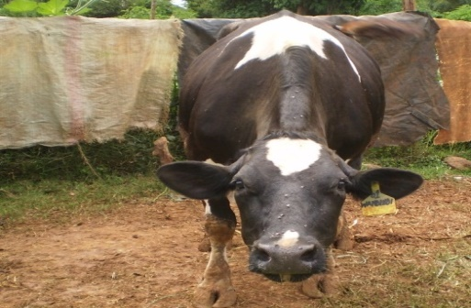
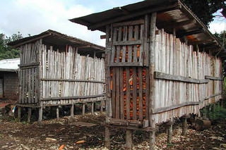
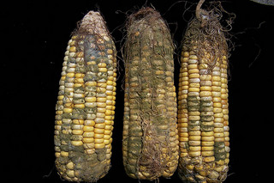


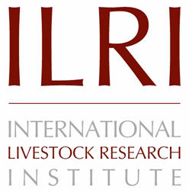


Efficacy of mycotoxin binder on aflatoxin M1 and Mazzican on total bacterial count in raw milk among smallholder dairy farmers in Kisumu County, Kenya
Gladys Anyango, Florence Mutua, Irene Kagera, Pauline Andang'o, Delia Grace and Johanna Lindahl
Kenyatta University International Food Safety Conference
Nairobi, Kenya
20–24 May 2019
Notes:
There MUST be a CGIAR logo or a CRP logo. You can copy and paste the logo you need from the final slide of this presentation. Then you can delete that final slide
To replace a photo above, copy and paste this link in your browser: http://www.flickr.com/photos/ilri/sets/72157632057087650/detail/
Find a photo you like and the right size, copy and paste it in the block above.

Slide 2
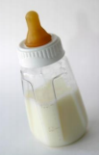
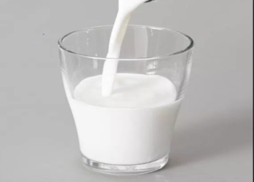
Introduction
  Food safety and quality are important issues in the world.
  Milk is an important part of human diet.
  Cow milk is the main type of milk used for human consumption corresponding to 83% of the world’s milk production.
  Milk has been shown to be contaminated with aflatoxin M1 (AFM1), a metabolite of aflatoxinB1 as well as bacteria
  Aflatoxins are harmful chemicals produced by certain moulds (Aspergillus flavus and A. parasiticus) which occur naturally in soil.

Slide 3
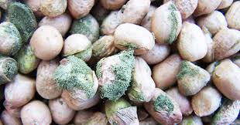
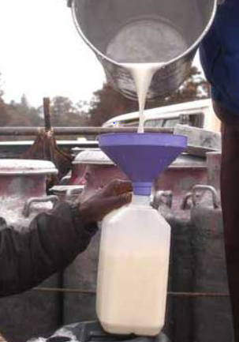
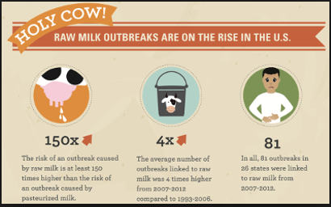
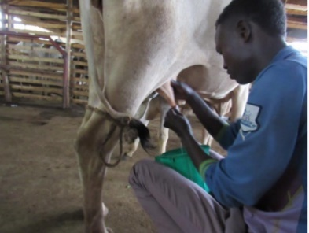
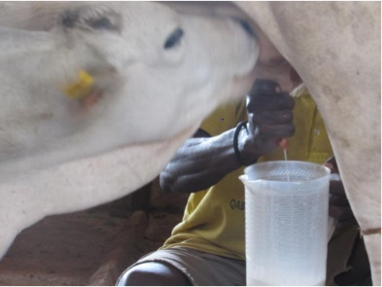
Introduction
Aflatoxins B1,B2,G1,G2 and M1 are classified as Group 1, carcinogenic to humans
Mainly contaminates food & feeds
Bacteria contaminate milk through mastitic cows, insufficiently cleaned milk equipment, environment and milking personnel

Slide 4
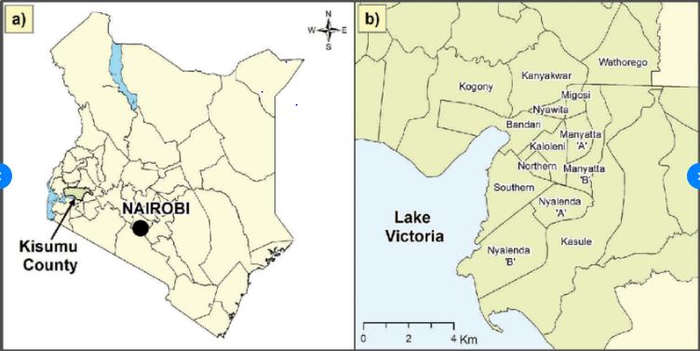
Milk safety burden in Kisumu
Kenya | Other towns
AFM1 prevalence rate is 72% | Nairobi 8% Eldoret 10% Nakuru 8% Kisumu 40%
TPC prevalence rate is 61-84% | Nairobi 20% , Eldoret 25% , Nakuru 25% Kisumu 47%

Slide 5
Statement of the problem
Immune suppression, stunting, carcinogenicity (30% of liver cancer)
Bacterial contamination in milk is responsible for 96% of foodborne illnesses
Dilution and chemical treatment ineffective, expensive and negatively influence the nutritional value of feed use of mycotoxin binders is needful
NovaSil® a bentonite clay, preserves the nutritional value of feed, high binding capacity.

Slide 6
Statement of the problem cont.
Use of metal milk containers is recommended to address bacterial milk contamination
Often they are too costly for smallholder dairy farmers with limited resources.
Use of traditional milk pails gathers contaminants easily leading to poor bacteriological quality in milk.
Use of Mazzican offers promising results in reducing total bacterial counts in milk.

Slide 7
Objectives
Main objective
To assess use of NovaSil binders and Mazzican milk containers in the control and prevention of aflatoxin m1 and bacterial contamination among smallholder dairy farmers in Kisumu County, Kenya

Slide 8
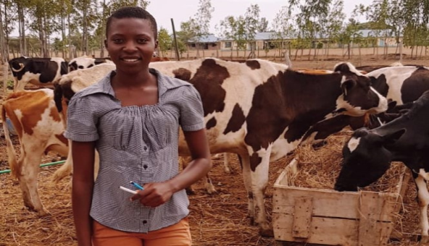
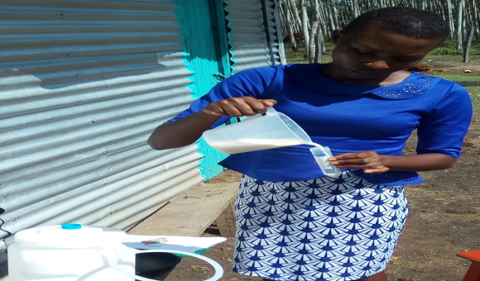
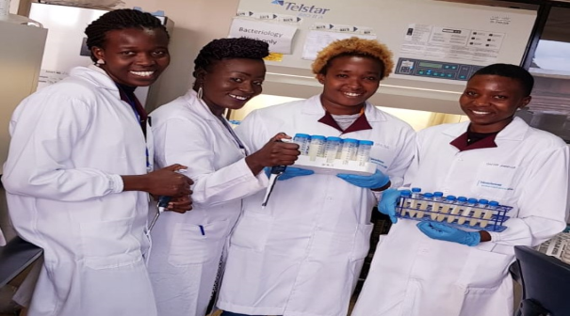
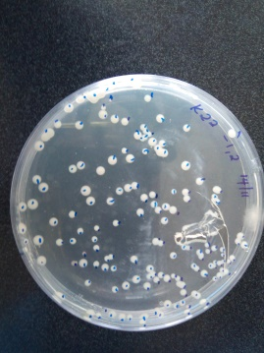
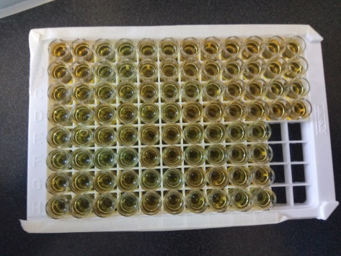
Materials and methods
Meeting with stakeholders
Baseline survey (questionnaire & milk)
Target 100;n=97
Trial ( 20 trial; 10 controls)
ELISA to test AFM1. LOD;2ppt
Total plate count was achieved through milk cultures (48hrs)

Slide 9
Results
Baseline: Occurrence levels of AFM1 in raw cow milk
Range of AFM1 (ppt) | Frequency of samples | % of samples
< LOD-19ppt | 45 | 62.5%
20-49ppt | 8 | 11.1%
Above 50ppt | 19 | 26.4%
Total(N) | 72 | 100%
AFM1 ranged from <LOD-151ppt

Slide 10
Baseline results cont……
Baseline responses on types and sources of diary feed
Feed type | On farm formulations (%) | Local purchases (%)
Hay | 9.3% (9/97) | 14.4% (14/97)
Cut and carry | 73.2%(71/97) | 10.3%(10/97)
Concentrates | 3.1%(3/97) | 58.8%(57/97)
Silage | 9.3%(9/97) | 2.1%(2/97)
Molasses | 1%(1/97) | 43.3%(42/97)
62.9% gave concentrates, significant p=0.002(OR 10.06)

Slide 11
Baseline aflatoxin awareness
61.8% farmers had heard of aflatoxins: men (67.2%),women (48.5%), difference insignificant (p=0.07).
37.1% could correctly define what aflatoxins were; i.e. as food poison (19.6%), as toxic mold (17.5%).
Incorrect definitions (24.7%), bacteria (10.3%), disease (10.3%), could not define (4.1%).

Slide 12
Farm trial
Trial Intervention (NovaSil clay) 20; control 10
  Farmer training on aflatoxins and use of binder
  NovaSil provided to the farmer, with instructions
  Dosing not supervised
  Farmer training on hygienic milk handling and use of Mazzican
Questionnaires and milk sampling biweekly

Slide 13
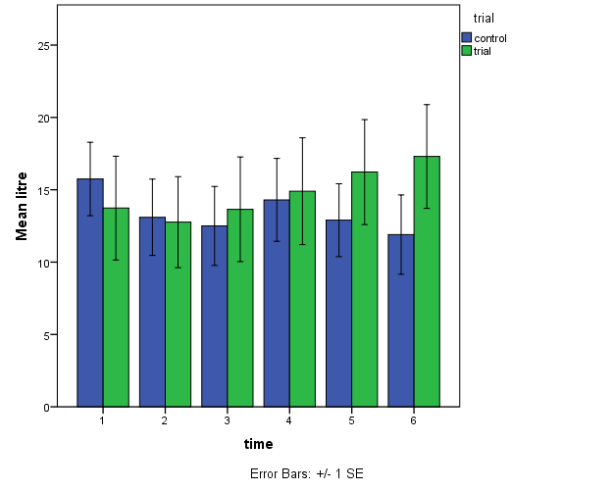
Trial: Milk production
Trend that trial farms have increased milk yield
Fig. 1: Variations in milk production in a trial study involving NovaSil.

Slide 14
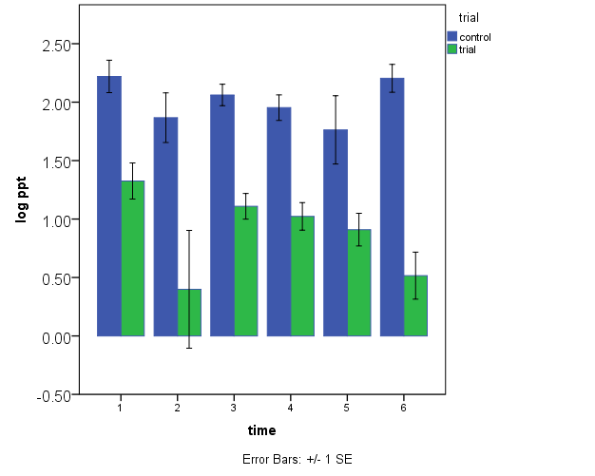
Trial: AFM1 levels in raw cow milk
On average 44% lower than start
Fig. 2: Variations in AFM1 in a trial study involving NovaSil.

Slide 15
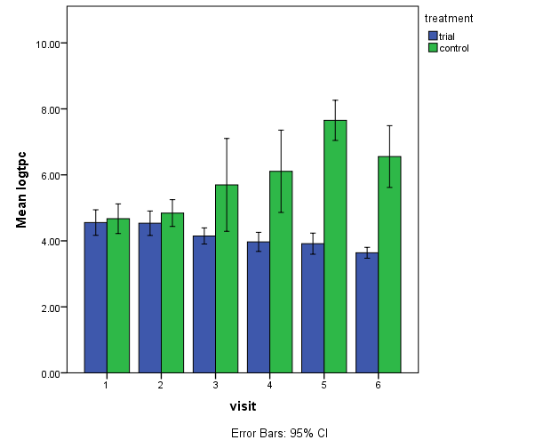
Mazzican on TPC
There was a significant difference in tpc between trial and control group p=0.002
Fig. 3: Variations in TPC in a trial study involving Mazzican.

Slide 16
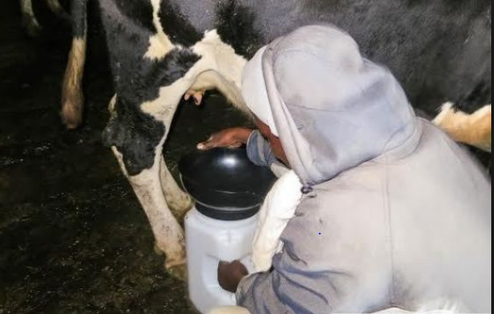
Conclusion
Intervention with NovaSil and Mazzican:
  Reduce AFM1 in milk
  Trend with increased milk yield
  Reduced total plate counts in milk
Farmers were complying and feeding
Farmers were willing to invest in the intervention

Slide 17
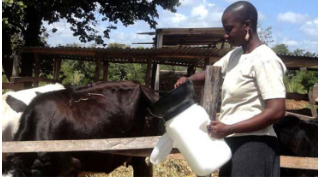
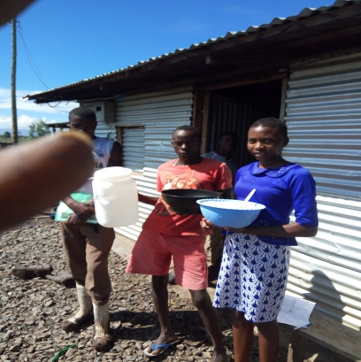
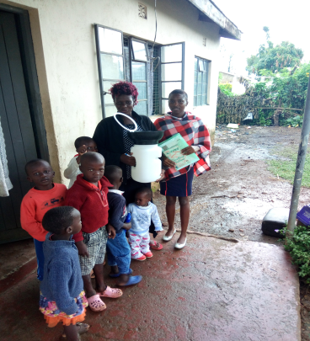
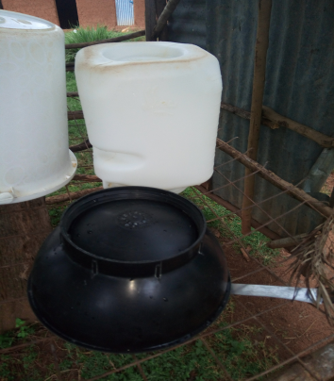
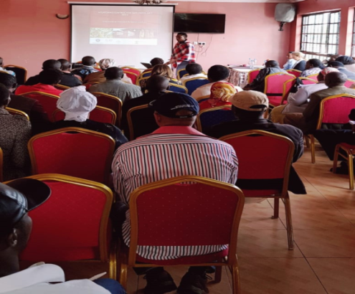

Recommendation
Possibility to supply farmers with NovaSil should be further investigated.
Further studies on effects of NovaSil on milk quality and other nutritional parameters.
Increase awareness on aflatoxins and bacteria in milk.

Slide 18




THANK YOU FOR LISTENING

