Slide 1


Investing in
GIS TECHNOLOGY
for better Urban futures
Prepared by:
Mathenge Mwehe
GIS Expert/Urban Planner
Lecturer at Maseno University
Geo-Spatial Africa Ltd.
Providing GIS Consultancy, & Capacity building
Mathenge Mwehe, (CEO)

Slide 2
need for gis in the workforce
Do you feel overwhelmed when making complex, data-driven decisions?
Do you have trouble communicating your insights to key policy-makers, funders, communities and constituents?
How can you find hidden spatial patterns in complicated decision-making scenarios? How can you analyze and visualize large amounts of quantitative data?
?
Geographic Information System (GIS) has the potential to help with all of these crucial and difficult activities.
But ,what is GIS?
GIS
Notes:
2004: US Secretary of Labor identifies geospatial technology as one of the 3 most important evolving fields.
Over 7,000 Universities Worldwide teach GIS

Slide 3
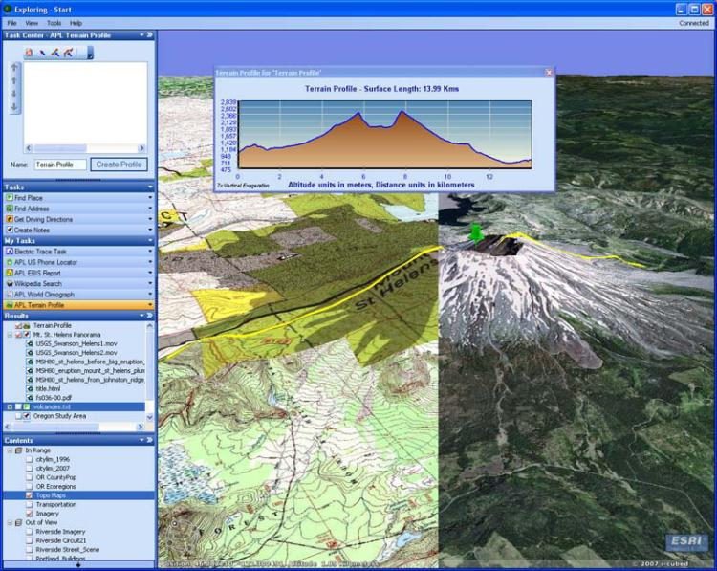
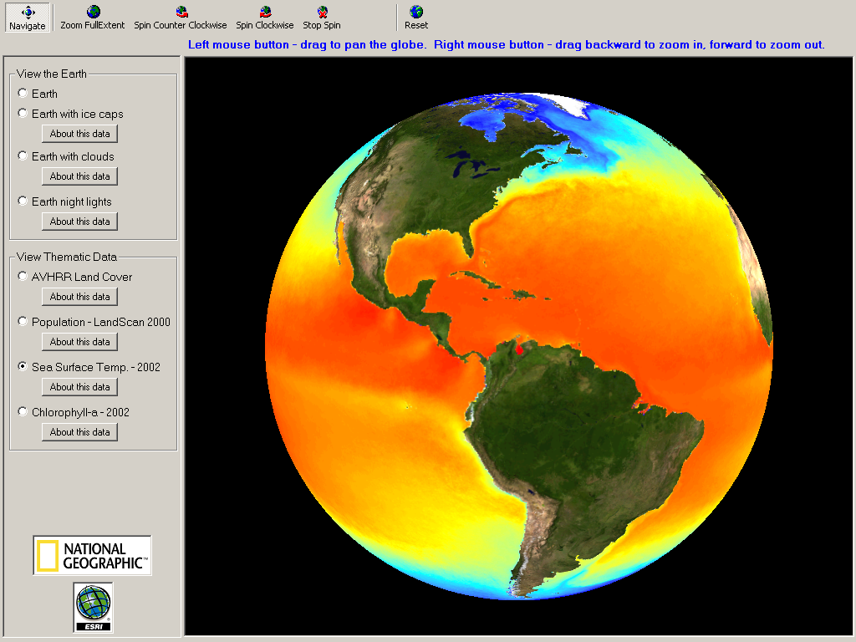
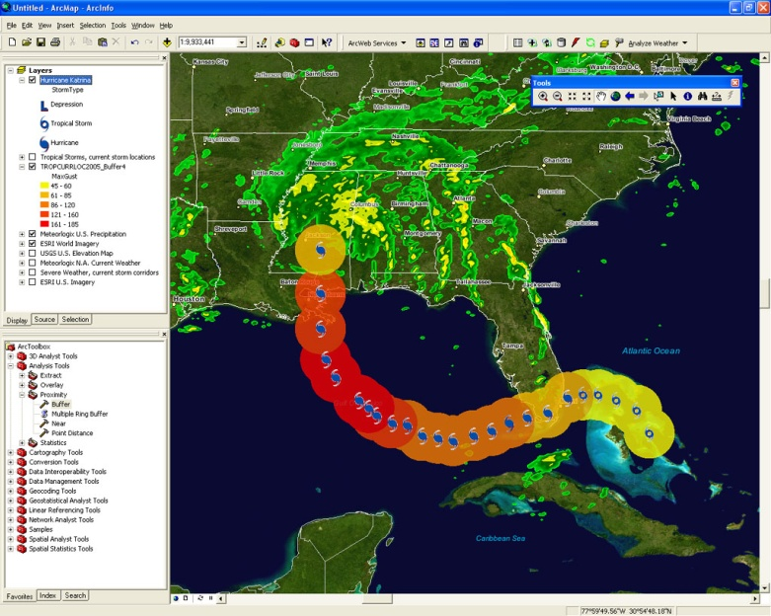
What is GIS?
GIS
GIS stands for
Geographic Information Systems
GIS

Slide 4

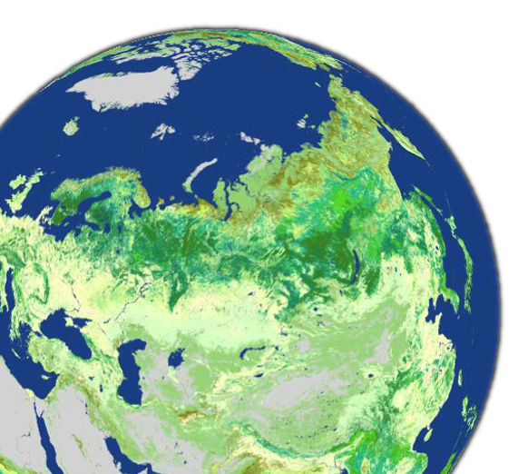


GIS: A Framework for Understanding and Managing Our Earth
Geographic Knowledge
Creating
Measuring
Organizing
Analyzing
Modeling
display
Holistic
Comprehensive
Systematic
Analytic
Visual
Applying
Planning
Managing
Decision making
Acting
GIS

Slide 5
GIS therefore is
A computer-based system for the storage, retrieval, manipulation, analysis, and display of geo-referenced spatial data. As a system it consist of;
People
Software
Data
Applications
GIS
Procedures
Hardware
GIS

Slide 6
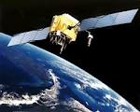
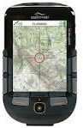

Geographic Information Technologies
Consist of
Remote Sensing (RS)
-Use of satellites or aircraft to capture information (land cover) about the earth’s surface
Global Positioning Systems (GPS)
- A system of earth-orbiting satellites which can provide precise (X,Y) Location on the earth’s surface
Geographic Information Systems (GIS)
-Systems with capability for input, storage, manipulation/analysis and display of spatial information
GPS and RS are sources of input data for a GIS.
Notes:
- GPS is a system of earth-orbiting satellites which can provide precise Location on the earth’s surface (in lat/long coordinates or equiv.)
Rs is use of satellites or aircraft to capture information about the earth’s surface
GIS is software systems with capability for input, storage, manipulation/analysis and output/display of geographic (spatial) information

Slide 7
From Paper Maps to Digital technology
GIS is based on the active integration of real-world data;
  This data is created through various processes:
    1. Digitization
    2. GPS mapping
    3. Scanning
    4. Manual entry based on real-world coordinate
    5. Coordinate Geometry (map projections)

Slide 8
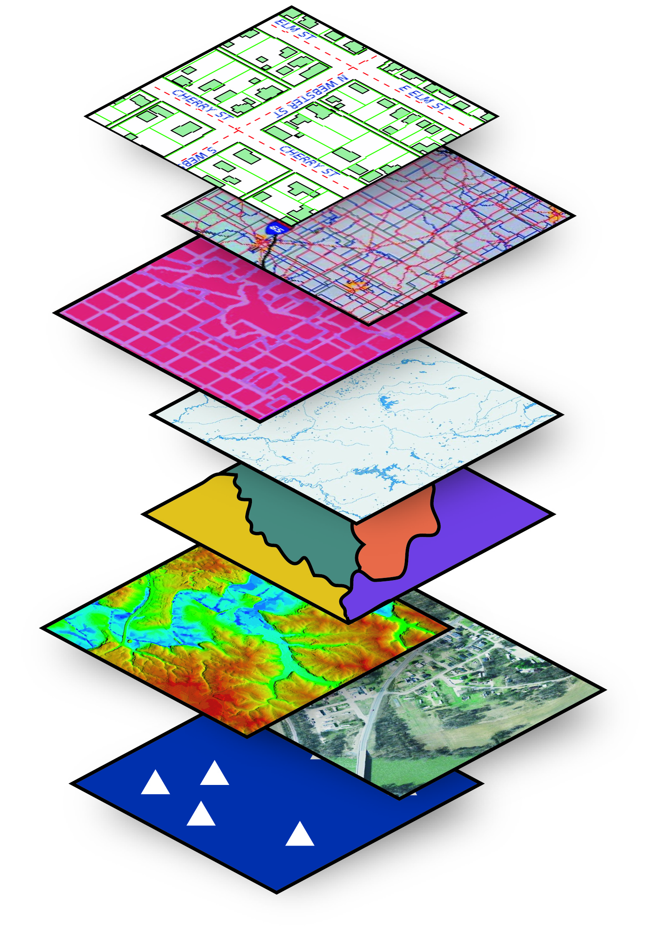
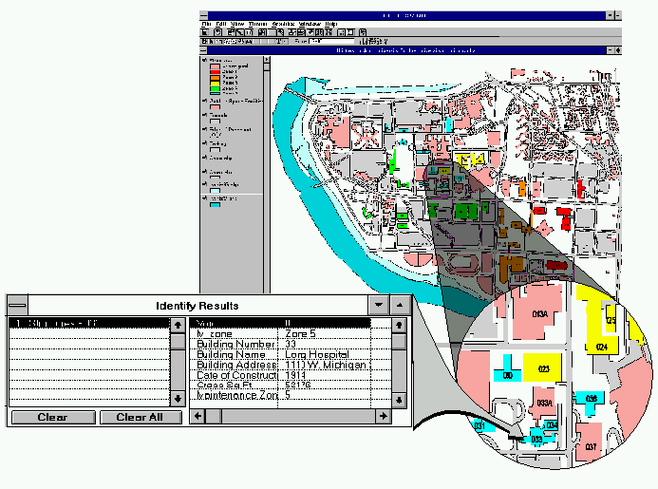
Why is GIS unique...?
GIS integrate Spatial (map data) and their non-spatial (attribute information) into one “system” that allows the user to interact with both aspects simultaneously.
It stores information about the world as a collection of thematic layers that are linked together through geo-referencing.
In a GIS, the maps have tables
of data behind them (Spatial databases).
This means when you combine different maps you combine data to get the information
you need.

Slide 9
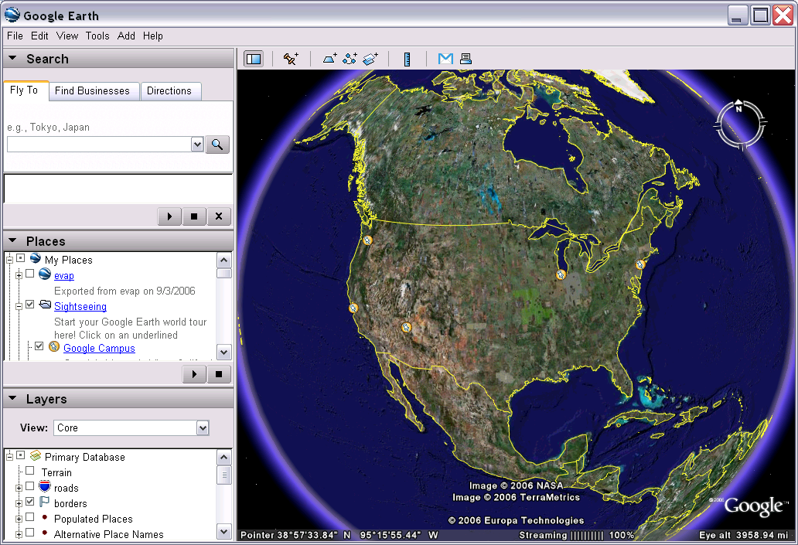
Recent Advancement of GIS technology
Google Earth Geographic Web Browser
http://earth.google.com/

Slide 10
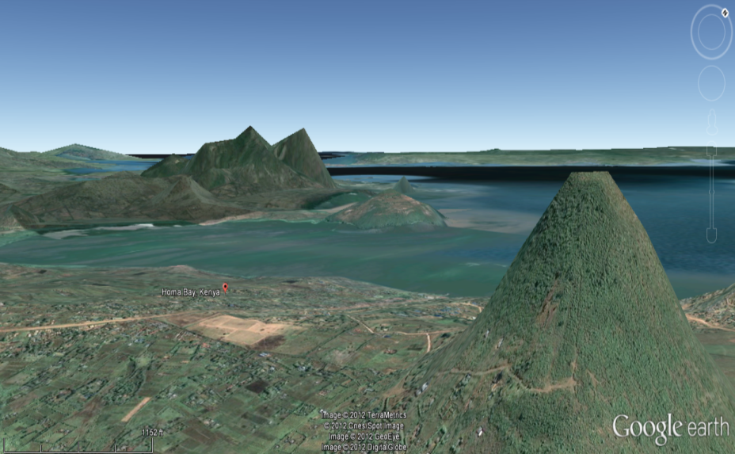
GIS enable urban planners to make a 3D visualization of urban space for better conception for planning purposes
3D view of Homa Bay town
From Google Earth technology

Slide 11
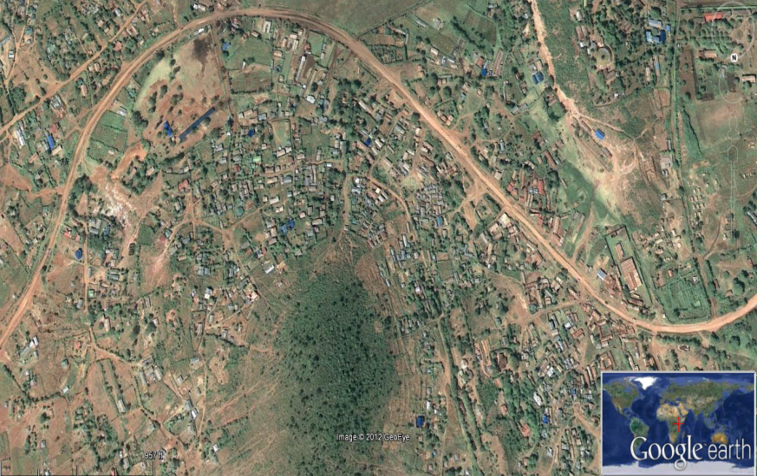
An aerial view of urban development of
Homa Bay town
Geo-Modeling of Urban space helps planners to understand complex urban relationship in GIS
GIS

Slide 12
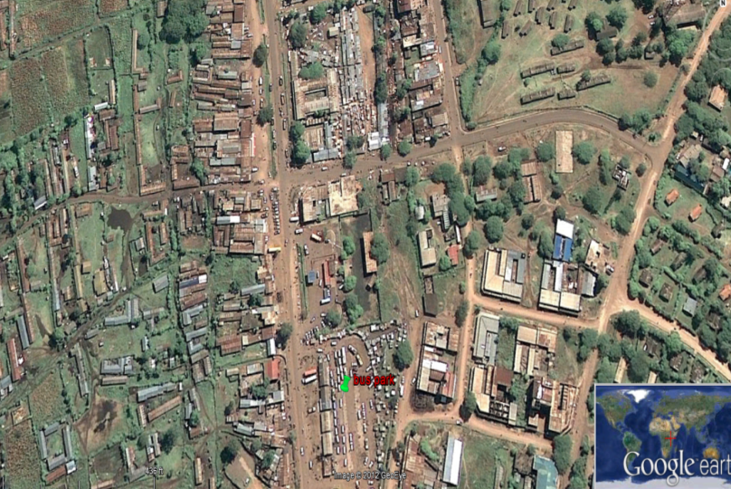
GIS Application Areas
Examples Illustrating How GIS can be
Applied
in Urban planning
GIS has thousands of
Real-world Applications
Homa Bay town
Staff training
and GIS adoption
Better Urban Plans
GIS

Slide 13
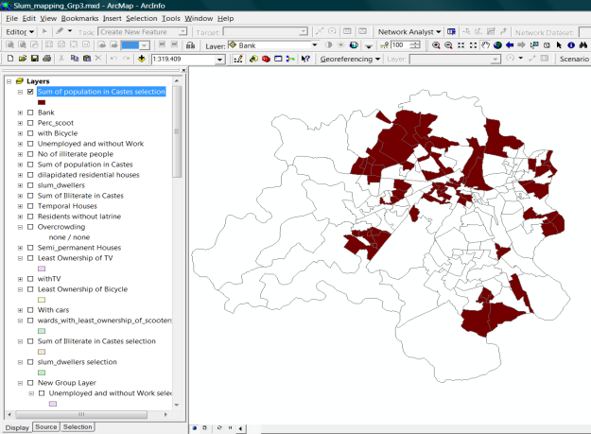
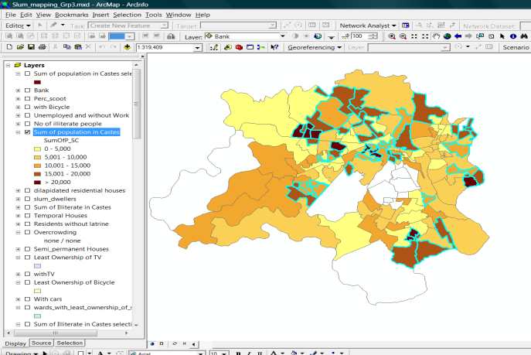
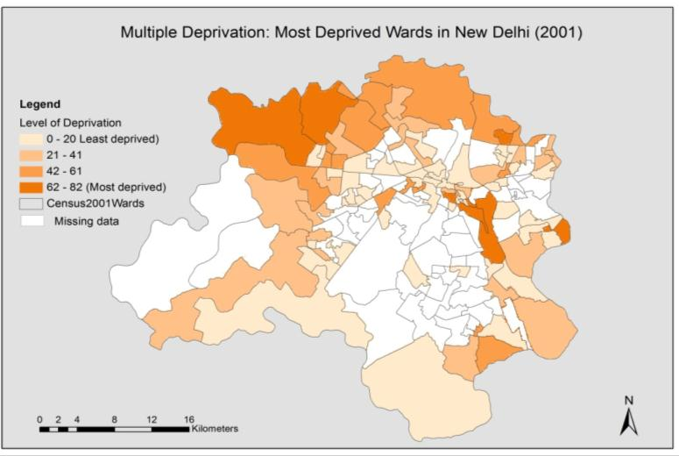
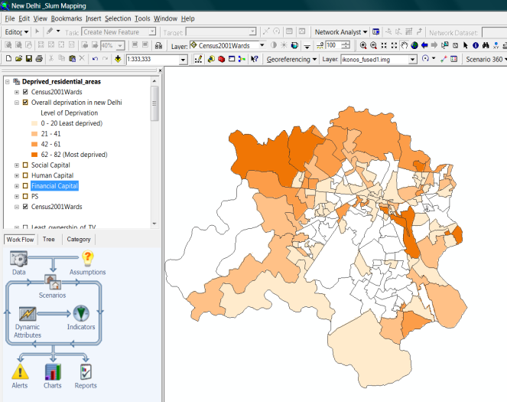
Poverty Mapping (using Population Census Data in GIS)
Extract layers
Define and visualize poverty Indicators
Census data
Set thresholds
Step 2
Step 1
“Highest poverty” ward layers in each indicators
Results
Visualize results
GIS
Step 4
Step 3

Slide 14

How can we identify and map deprived residential areas
in urban areas?
Using high resolution satellite image and census data it is possible to identify and map poverty stricken residential areas within towns.
urban poverty analysis
Most poor wards
GIS

Slide 15
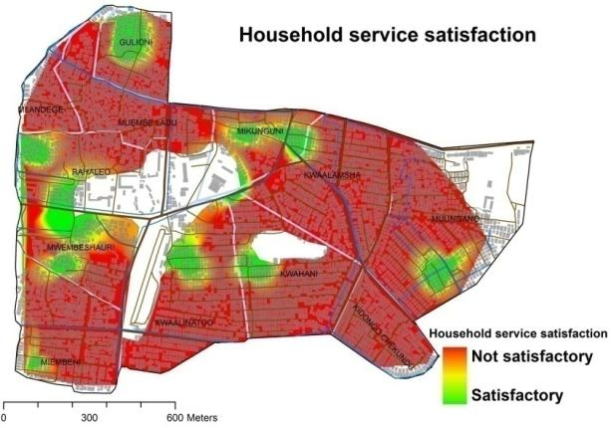
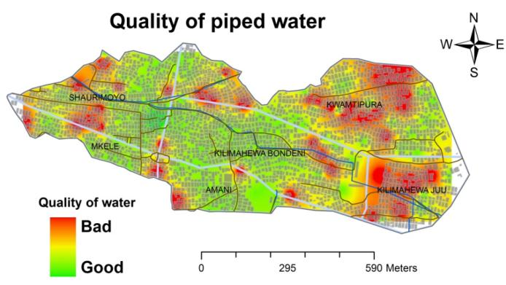
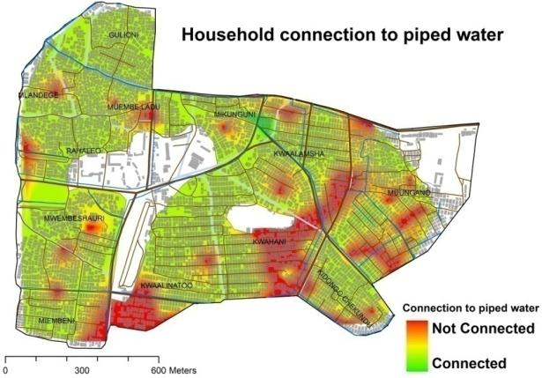
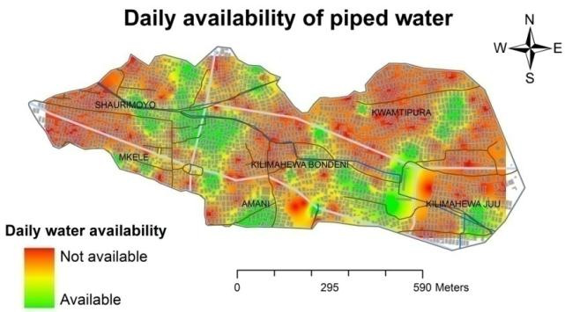
GIS enable us to map water service provision planning
For better urban water service delivery
Study carried out in Zanzibar slum areas by Mathenge Mwehe (2010)

Slide 16
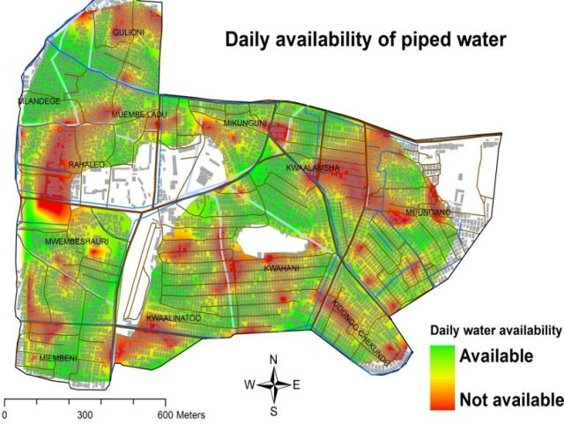
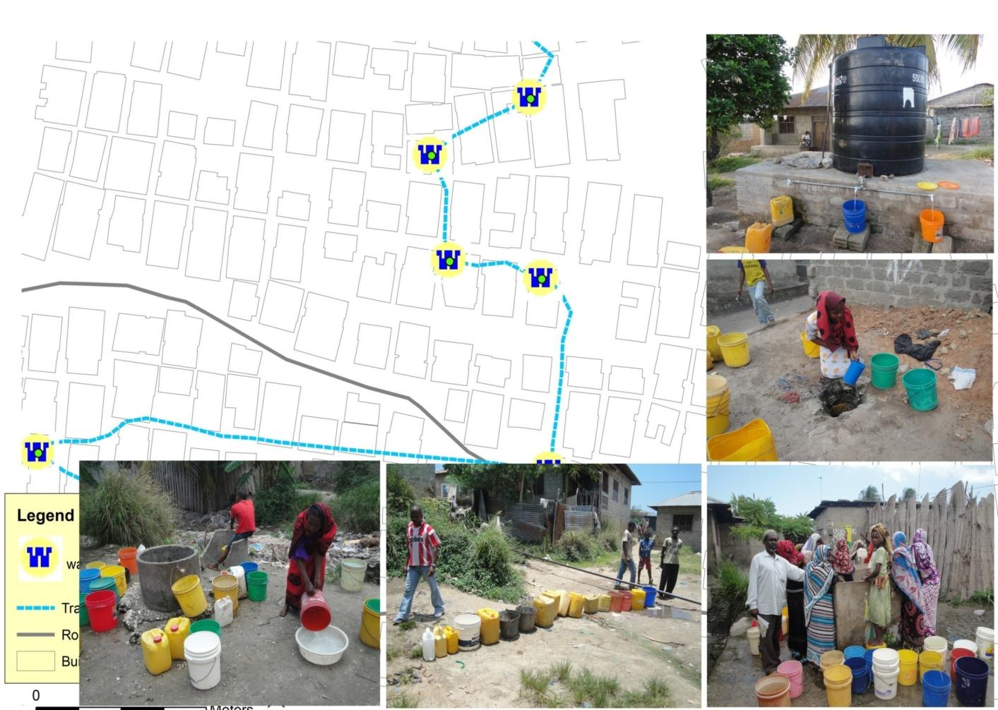
water service provision planning
Study carried out in Zanzibar slum areas by Mathenge Mwehe (2010)
Can be accessed via this link:> http://www.itc.nl/library/papers_2011/msc/upm/mathenge.pdf

Slide 17
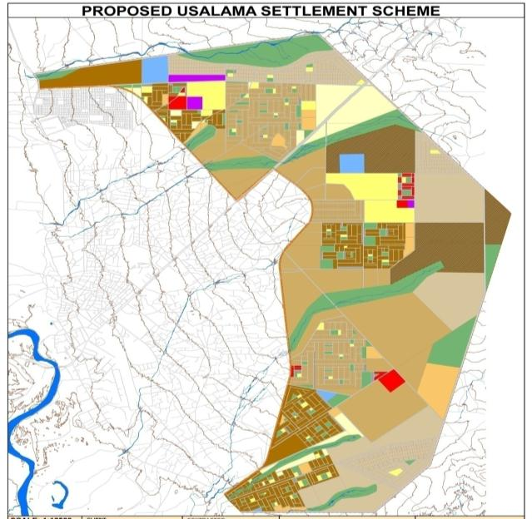
GIS applied in spatial plan preparation
GARISSA
ZONING PLAN

Slide 18
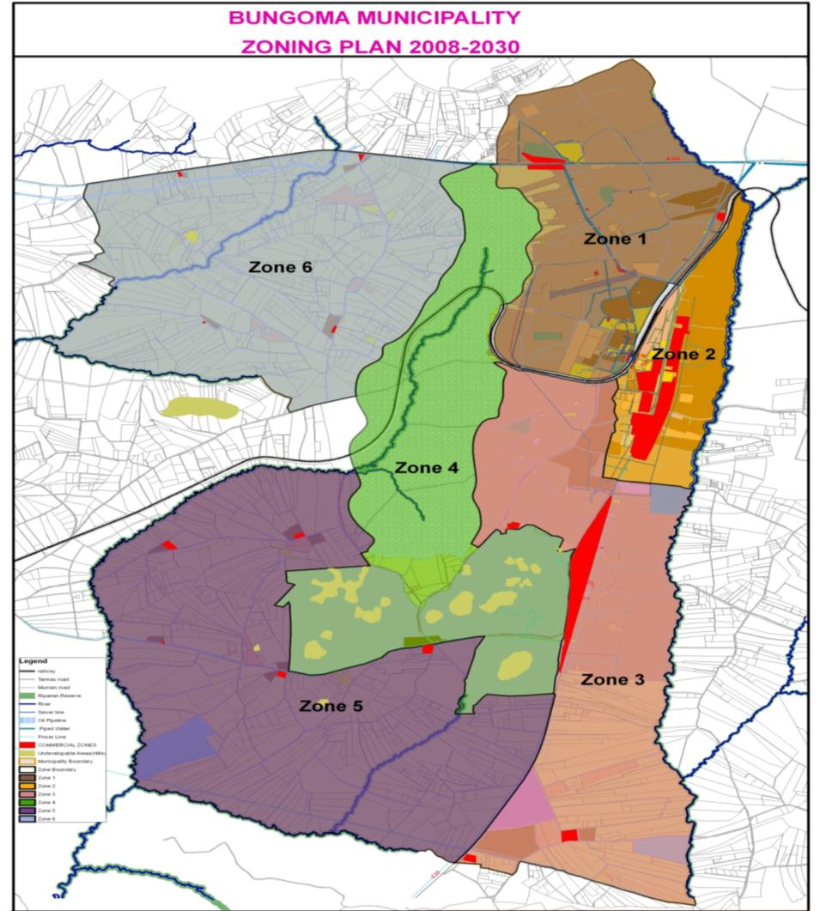
GIS applied in spatial plan preparation
BUNGOMA
ZONING PLAN
GIS

Slide 19
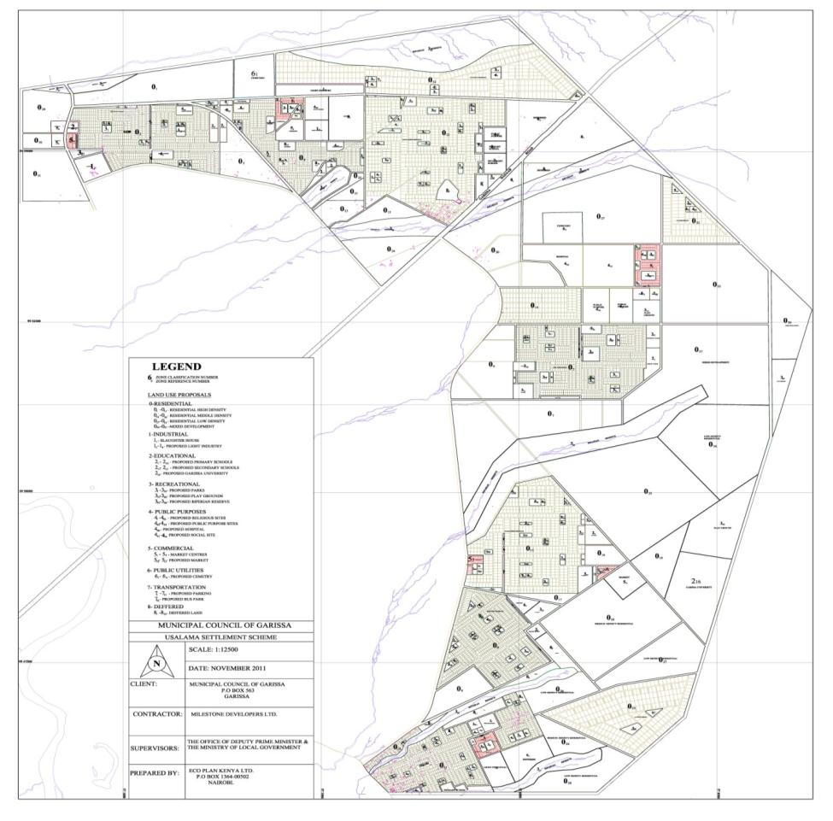
GIS applied in spatial plan preparation
USALAMA
SETTLEMENT
SCHEME
(GARISSA)
GIS

Slide 20
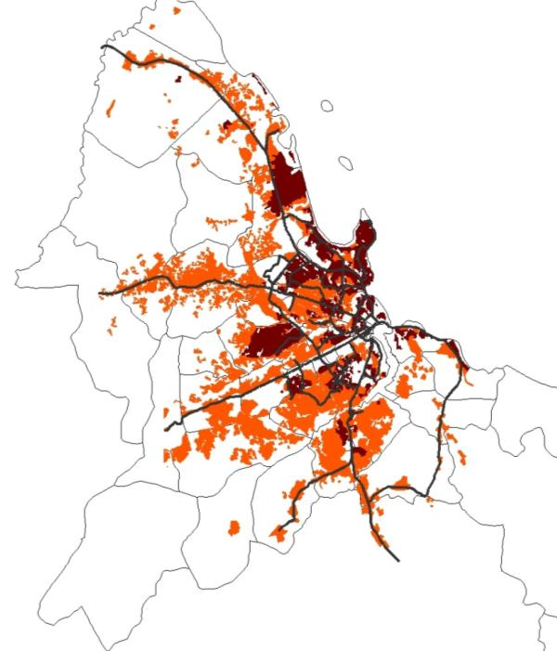
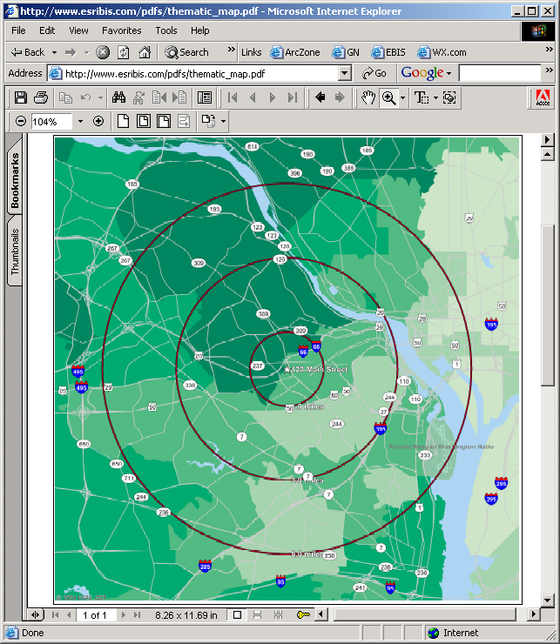
What can we do with GIS in urban planning?
Land Use/Zoning
Emergency Preparedness
Property Tax Assessment
Transportation planning
Mapping Environmental health and justice
Mapping of Urban Growth
Epidemiology/Disease Tracking
Water Quality and Availability
Population Forecast
Identifying vulnerability
Monitoring wells, hazardous waste sites
Mapping access to health care facilities
Monitoring
Urban
Sprawl
GIS

Slide 21

Maseno University has well trained
GEO-SPATIAL EXPERTS
and well equipped Digital GIS LAB
for training and capacity building of staff on GIS Mapping
Need to train staff on
GIS TECHNOLOGY ?
GIS technology is an indispensable tool in urban planning that need to be adopted
GIS

Slide 22
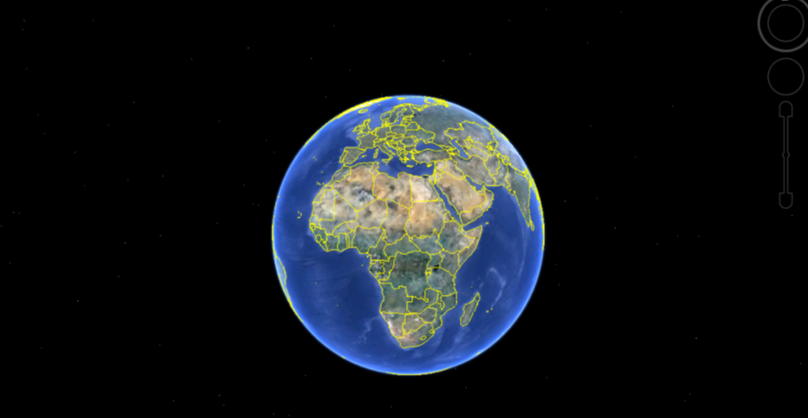
…Finally
Over 7,000 Universities Worldwide teach GIS - Maseno University (School of Planning, Maseno University) is proud to be among them.
The earth is the only Source of Survival for humankind
It is our Responsibility to take care of it
GIS

Slide 23
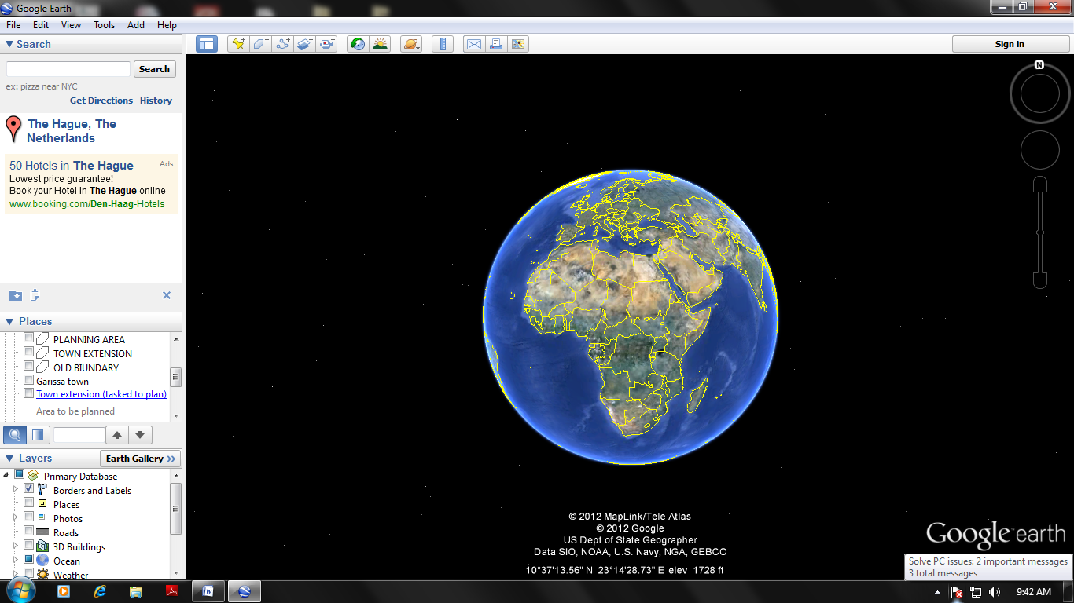
The End
Prepared by:
Mathenge Mwehe, GIS Expert/Urban Planner.
Lecturer at GIS Department, Maseno University
mathengemwehe@gmail.com
mathenge24118@itc.nl
Tel: 0724302883

